Slide 1
Projective 3D geometry class 4
Multiple View Geometry
Comp 290-089
Marc Pollefeys

Slide 2
Content
Background: Projective geometry (2D, 3D), Parameter estimation, Algorithm evaluation.
Single View: Camera model, Calibration, Single View Geometry.
Two Views: Epipolar Geometry, 3D reconstruction, Computing F, Computing structure, Plane and homographies.
Three Views: Trifocal Tensor, Computing T.
More Views: N-Linearities, Multiple view reconstruction, Bundle adjustment, auto-calibration, Dynamic SfM, Cheirality, Duality

Slide 3
Multiple View Geometry course schedule
(subject to change)
Jan. 7, 9 | Intro & motivation | Projective 2D Geometry
Jan. 14, 16 | (no course) | Projective 2D Geometry
Jan. 21, 23 | Projective 3D Geometry | Parameter Estimation
Jan. 28, 30 | Parameter Estimation | Algorithm Evaluation
Feb. 4, 6 | Camera Models | Camera Calibration
Feb. 11, 13 | Single View Geometry | Epipolar Geometry
Feb. 18, 20 | 3D reconstruction | Fund. Matrix Comp.
Feb. 25, 27 | Structure Comp. | Planes & Homographies
Mar. 4, 6 | Trifocal Tensor | Three View Reconstruction
Mar. 18, 20 | Multiple View Geometry | MultipleView Reconstruction
Mar. 25, 27 | Bundle adjustment | Papers
Apr. 1, 3 | Auto-Calibration | Papers
Apr. 8, 10 | Dynamic SfM | Papers
Apr. 15, 17 | Cheirality | Papers
Apr. 22, 24 | Duality | Project Demos

Slide 4

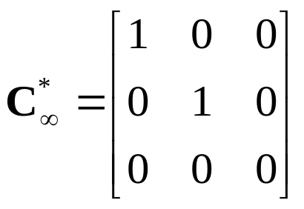
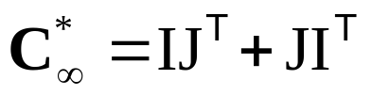
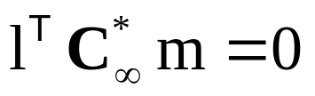
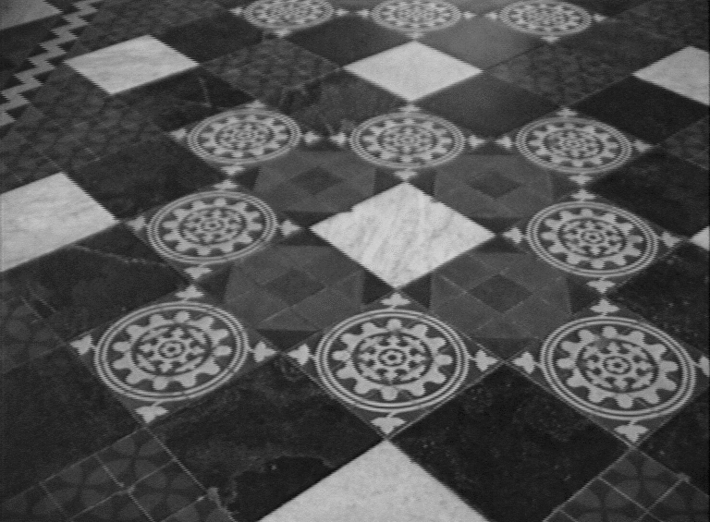
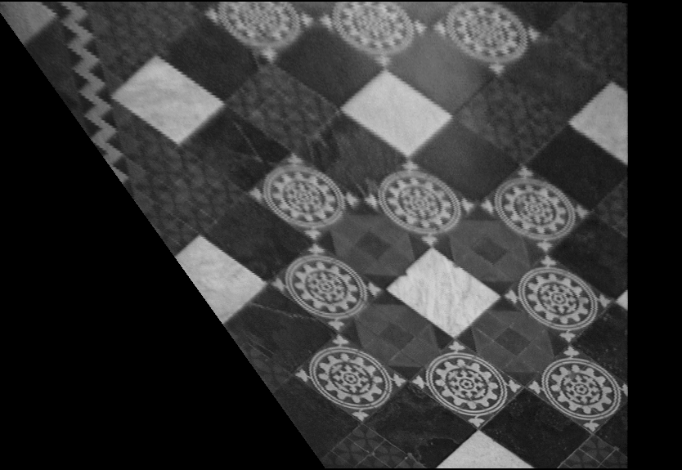
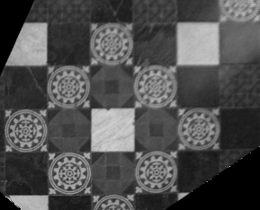
Last week …
line at infinity (affinities)
circular points (similarities)
(orthogonality)

Slide 5
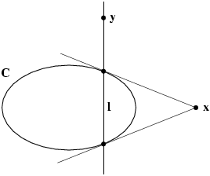
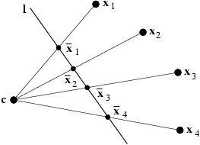


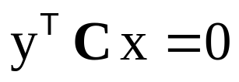


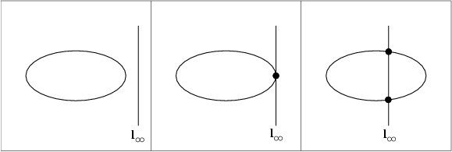
Last week …
pole-polar relation
cross-ratio
conjugate points & lines
Chasles’ theorem
projective conic classification
A
B
C
affine conic classification
X
D

Slide 6
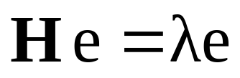
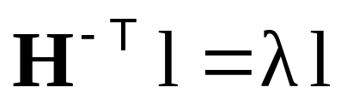
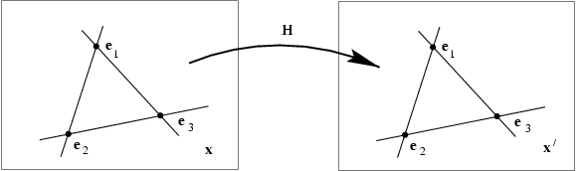
Fixed points and lines
(eigenvectors H =fixed points)
(λ₁=λ₂ ⇒ pointwise fixed line)
(eigenvectors H^{-T} =fixed lines)

Slide 7
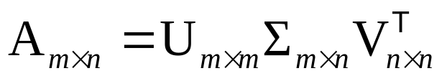

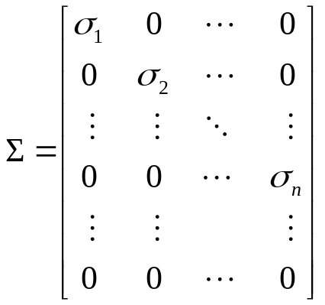







Singular Value Decomposition

Slide 8
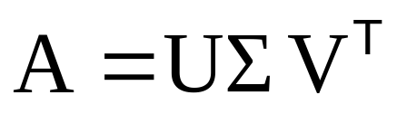
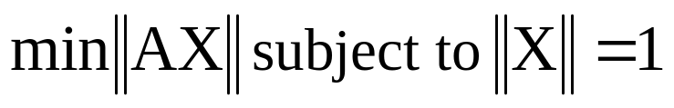
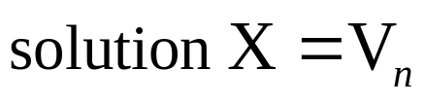
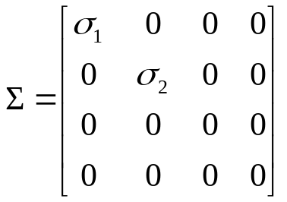


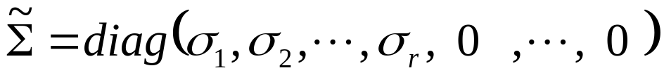

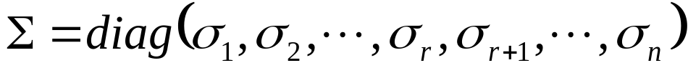

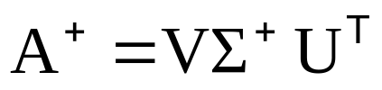
Singular Value Decomposition
Homogeneous least-squares
Span and null-space
Closest rank r approximation
Pseudo inverse

Slide 9
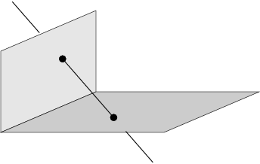
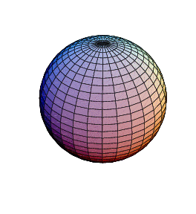
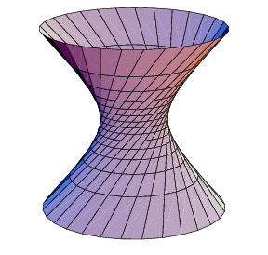
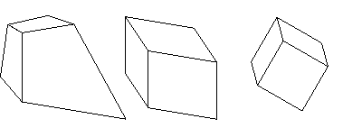
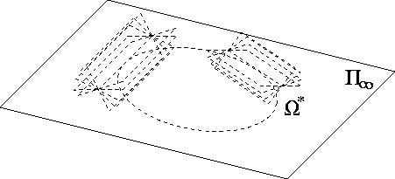
Projective 3D Geometry
Points, lines, planes and quadrics
Transformations
П∞, ω∞ and Ω ∞

Slide 10

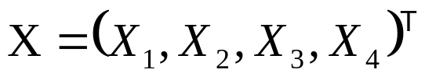
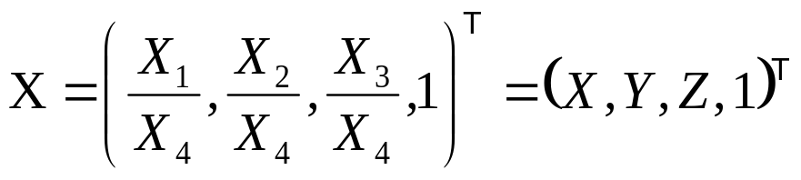


3D points
3D point
in R³
in P³
projective transformation
(4x4-1=15 dof)

Slide 11
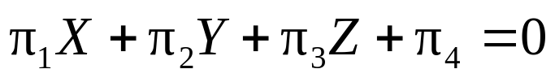

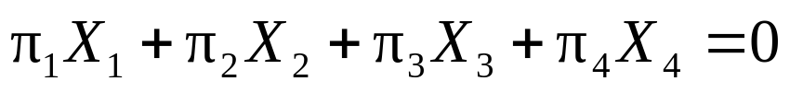


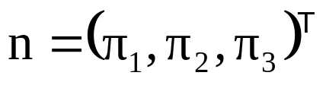
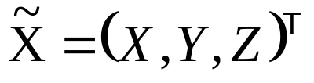


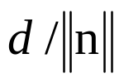
Planes
3D plane
Transformation
Euclidean representation
Dual: points ↔ planes, lines ↔ lines

Slide 12
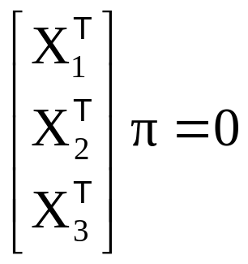
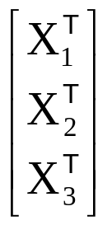

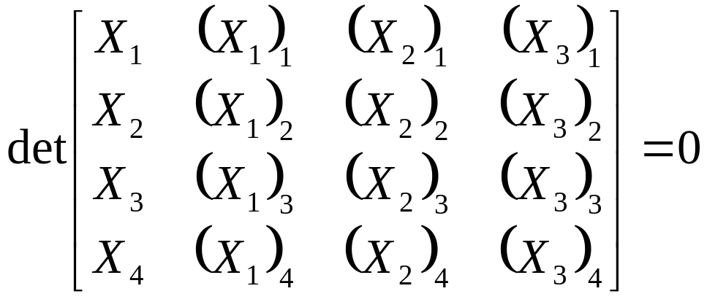
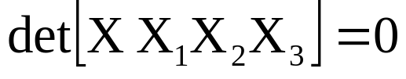
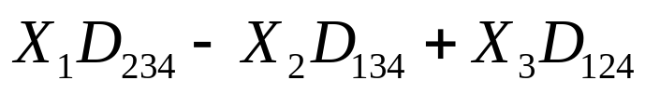
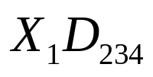
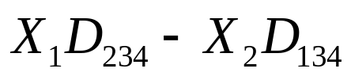
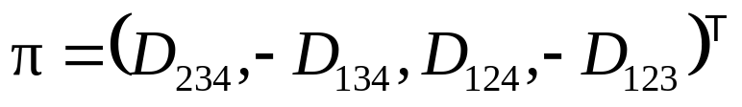
Planes from points
(solve as right nullspace of )
Or implicitly from coplanarity condition

Slide 13
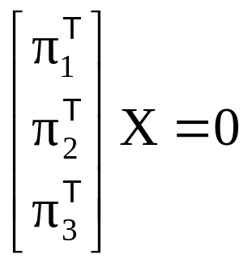
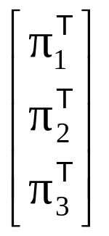



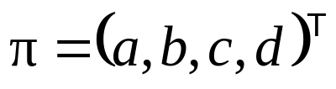

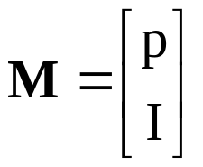
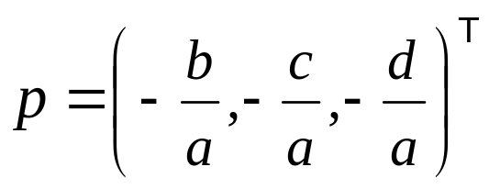
Points from planes
(solve as right nullspace of )
Representing a plane by its span

Slide 14
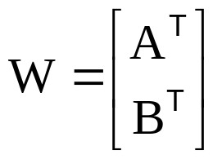

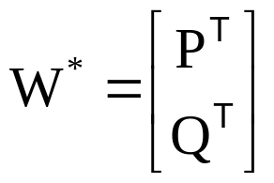

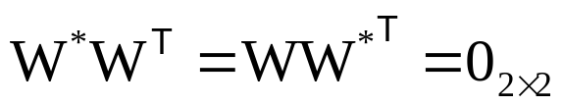


Lines
(4dof)
Example: X-axis

Slide 15







Points, lines and planes

Slide 16






Plücker matrices
Plücker matrix (4x4 skew-symmetric homogeneous matrix)
L has rank 2
4dof
generalization of
L independent of choice A and B
Transformation
Example: x-axis
Notes:
A,B on line AW*=0, BW*=0, …
4dof, skew symmetric 6dof, scale -1, rank2 -1
Prove independence of choice by filling in C=A+muB, AA-AA disappears, …
Prove transform based on A’=HA, B’=HB,…

Slide 17







Plücker matrices
Dual Plücker matrix L*
Correspondence
Join and incidence
(plane through point and line)
(point on line)
(intersection point of plane and line)
(line in plane)
(coplanar lines)
Notes:
Indicate 12-34 {1234} always present
Prove join (AB’+BA’)P=A (if A’P=0) which is general since L independent of A and B
Example intersection X-axis with X=1: X=counterdiag(-1 0 0 1)(1 0 0 -1)’=(1 0 0 1)’

Slide 18







Plücker line coordinates
on Klein quadric
Notes:
L consists of non-zero elements

Slide 19




Plücker line coordinates
(Plücker internal constraint)
(two lines intersect)
(two lines intersect)
(two lines intersect)

Slide 20









Quadrics and dual quadrics
(Q : 4x4 symmetric matrix)
9 d.o.f.
in general 9 points define quadric
det Q=0 ↔ degenerate quadric
pole – polar
(plane ∩ quadric)=conic
transformation
relation to quadric (non-degenerate)
transformation
Notes:
3. and thus defined by less points
4. On quadric=> tangent, outside quadric=> plane through tangent point
5. Derive X’QX=x’M’QMx=0

Slide 21
Quadric classification
Rank | Sign. | Diagonal | Equation | Realization
4 | 4 | (1,1,1,1) | X²+ Y²+ Z²+1=0 | No real points
 | 2 | (1,1,1,-1) | X²+ Y²+ Z²=1 | Sphere
 | 0 | (1,1,-1,-1) | X²+ Y²= Z²+1 | Hyperboloid (1S)
3 | 3 | (1,1,1,0) | X²+ Y²+ Z²=0 | Single point
 | 1 | (1,1,-1,0) | X²+ Y²= Z² | Cone
2 | 2 | (1,1,0,0) | X²+ Y²= 0 | Single line
 | 0 | (1,-1,0,0) | X²= Y² | Two planes
1 | 1 | (1,0,0,0) | X²=0 | Single plane
Notes:
Signature sigma= sum of diagonal,e.g. +1+1+1-1=2,always more + than -, so always positive…

Slide 22






Quadric classification
Projectively equivalent to sphere:
sphere
ellipsoid
hyperboloid of two sheets
paraboloid
Ruled quadrics:
hyperboloids of one sheet
Degenerate ruled quadrics:
cone
two planes
Notes:
Ruled quadric: two family of lines, called generators.
Hyperboloid of 1 sheet topologically equivalent to torus!

Slide 23





Twisted cubic
twisted cubic
conic
3 intersection with plane (in general)
12 dof (15 for A – 3 for reparametrisation (1 θ θ²θ³)
2 constraints per point on cubic, defined by 6 points
projectively equivalent to (1 θ θ²θ³)
Horopter & degenerate case for reconstruction

Slide 24





Hierarchy of transformations
Projective
15dof
Intersection and tangency
Parallellism of planes,
Volume ratios, centroids,
The plane at infinity π∞
Affine
12dof
Similarity
7dof
The absolute conic Ω∞
Euclidean
6dof
Volume

Slide 25




Screw decomposition
Any particular translation and rotation is equivalent to a rotation about a screw axis and a translation along the screw axis.
screw axis // rotation axis

Slide 26



The plane at infinity
The plane at infinity π∞ is a fixed plane under a projective transformation H iff H is an affinity
canical position
contains directions
two planes are parallel ⇔ line of intersection in π∞
line // line (or plane) ⇔ point of intersection in π∞
Notes:
Represents 3DOF between projective and affine

Slide 27


The absolute conic
The absolute conic Ω∞ is a (point) conic on π∞.
In a metric frame:
or conic for directions:
(with no real points)
The absolute conic Ω∞ is a fixed conic under the projective transformation H iff H is a similarity
Ω∞ is only fixed as a set
Circle intersect Ω∞ in two points
Spheres intersect π∞ in Ω∞
Notes:
Represent 5 DOF between affine and similarity

Slide 28





The absolute conic
Euclidean:
Projective:
(orthogonality=conjugacy)
normal
plane
Notes:
Orthogonality is conjugacy with respect to Absolute Conic

Slide 29



The absolute dual quadric
The absolute conic Ω*∞ is a fixed conic under the projective transformation H iff H is a similarity
8 dof
plane at infinity π∞ is the nullvector of Ω∞
Angles:

Slide 30






Next classes:
Parameter estimation
Direct Linear Transform
Iterative Estimation
Maximum Likelihood Est.
Robust Estimation

